Slide 1

Influence of Weather Conditions on Energy Consumption in Lisbon and analysis of Domestic and Industrial regions
Big Data Mining
Professor Nuno Datia, Professora Matilde Pato, Professor Artur Ferreira

Slide 2
Presentation Plan
Understanding the Data Mining and Contextualization Problem
Data Interpretation
Dataset Characterization and Preprocessing
Data Imputation and dimensionality reduction
Questioning
Application of Models and Performance Assessment
Model comparison
Sampling methods comparison
Conclusion and future work

Slide 3
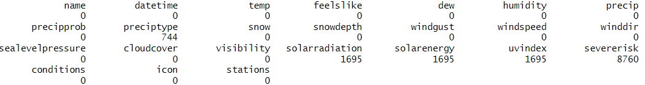
Data Interpretation – Weather
Weather characteristics in Lisbon in a two-year period
9504 instances with 24 features
Imputation based on median, mean, or zero, given standard deviation of original values

Slide 4
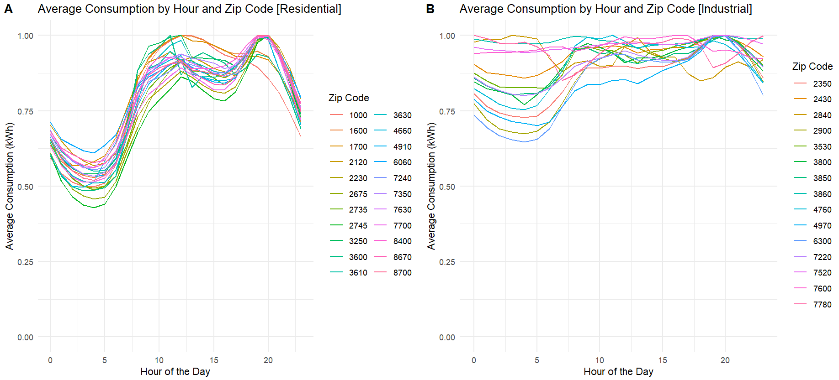
Data Interpretation – Energy
Energy Consumption for different Zip Codes in Portugal
Residential and Industrial categorization (ref: www.pordata.pt)
~3.7M instances with 5 features

Slide 5
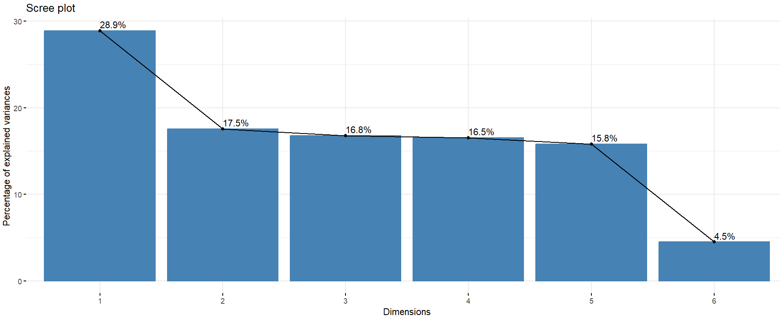
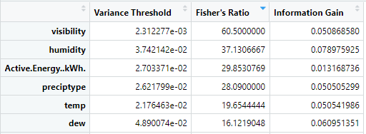
Questioning and data pre-processing
1 - “What Zip Codes are residential or Industrial given energy consumption characteristics?”
2 - “Can we accurately predict energy consumption in Lisbon given expected weather conditions?”
Feature Selection / Feature Reduction with 95% variance of original data
Principal Component Analysis

Slide 6
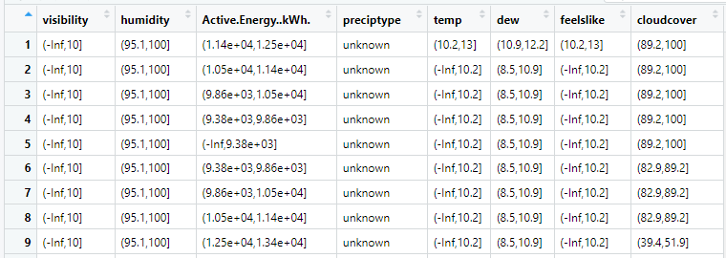
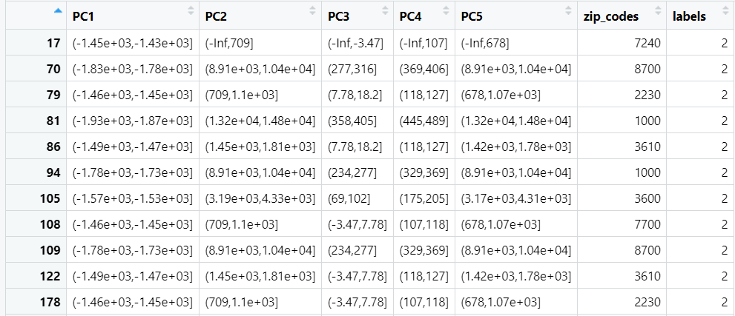
Questioning and data pre-processing
Data Discretization with Equal Frequency Binning
Bins then converted into discrete integers
Labels: 1 – Residential; 2 – Industrial

Slide 7
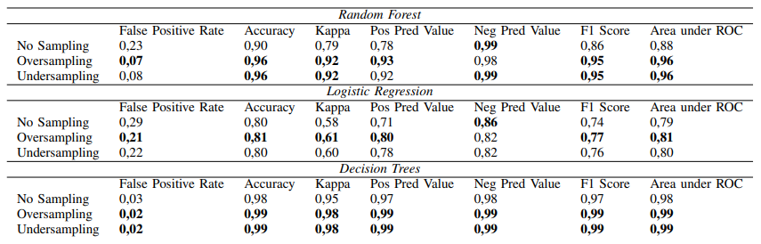

Question 1 – Classifying a Zip Code as Industrial or Residential
Best results for Decision Trees, performance to be investigated
Logistic Regression displays worst performance overall
Oversampling gets the best results
Random seed influences Random Forest and Logistic Regression

Slide 8
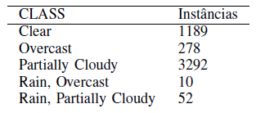
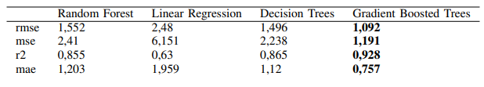
Question 2 – Predicting energetic consumption in Lisbon
Best results for Gradient Boosted Trees
Simplest model (Linear Regression) is the worst
Oversampling and undersampling distort the dataset

Slide 9
Conclusions and Areas for Improvement
The baseline models perform the worst for both scenarios with oversampling being the best
Some models were sensitive to the seed value, making them unfit for the problem.
Add a “Mixed” class for energetic consumption and apply One-vs-Rest model
Compare performance of reduced datasets vs original datasets
Further investigate performance of the Decision Trees model in both undersampling and oversampling cases.
Any questions?

